Slide 1

APP TRADER
10 apps to weather the COVID-19 Pandemic

Slide 2
Taking Care of Our Client
-~ talk about our task

Slide 3
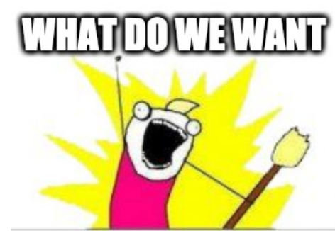

Slide 4
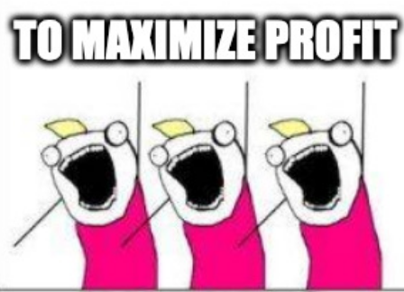

Slide 5
Your Wish List
Crossover Apps

Slide 6
So, you want maximize your profits with cross over apps?

Slide 7
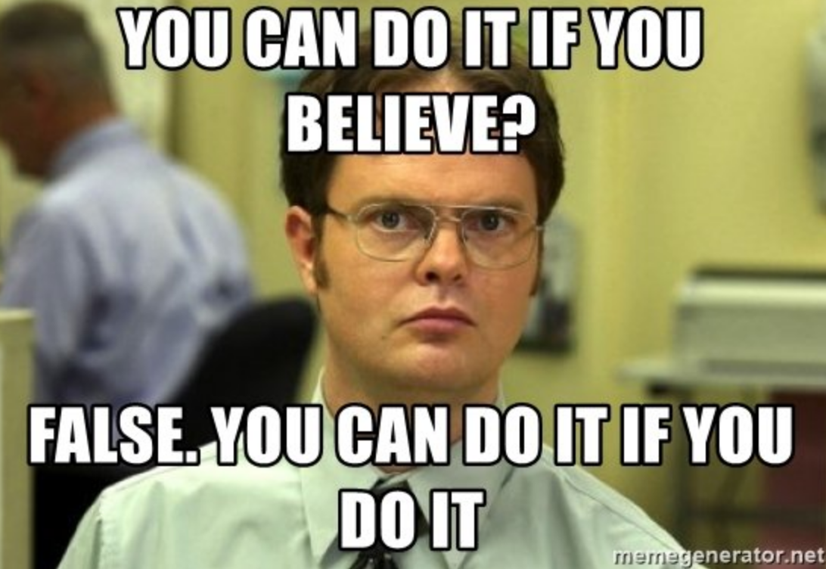

Slide 8

This is how you do it if you do it
Free Apps
High Product Rating for Longevity
Cross Over Apps

Slide 9


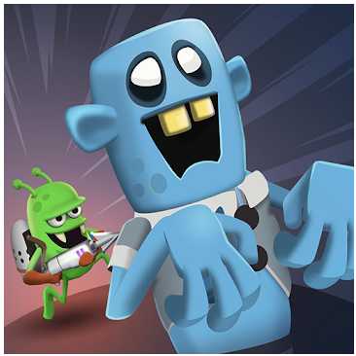
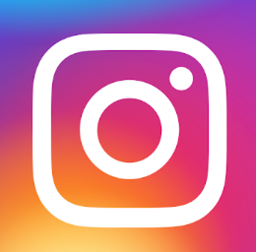
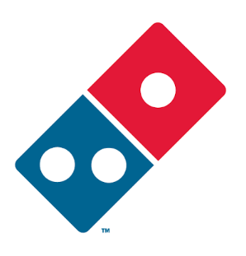
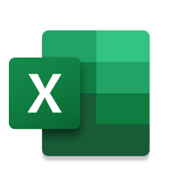

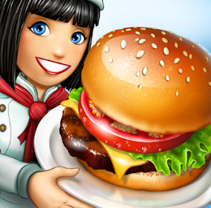
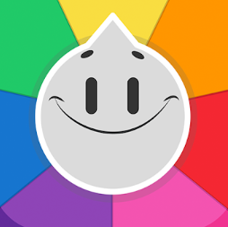
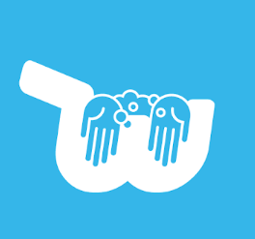
And This Is What We Did

Slide 10


But… HOW?

Slide 11

Free Apps – But Why?
Low upfront cost to purchase app
Users are more likely to pick YOUR app Which gives you a larger target market
Investment returned in 5 months
Upfront cost of $10,000
$2,500 average revenue from in app purchases
Check out the research!

Slide 12
Higher Ratings Create Longevity - But Why?
4.5 stars and above
For every half point that an app gains in rating, its projected lifespan increases by one year
9-10 years worth of in-app purchases revenue
More money for less

Slide 13
Crossover Titles
Are long term investment winners
Because they Maximize Marketing Fees

Slide 14

Crossover Titles – But Why?
1 App on Both Platforms
Fixed __________
One Time Licensing Per $10,000 x 2 Store
Ongoing __________
Marketing Cost Per App $1,000 Per Month Month
Avg Monthly Income & In App Purchases $2,500 Per Month
2 Similar Apps on the Different Platforms
Fixed _________
One Time Licensing Per $10,000 x 2 Store
Ongoing _________
Marketing Cost Per App $1,000 x 2 Per Month Month
Avg Monthly Income & In App Purchases $2,500 Per Month

Slide 15
Crossover Net Profit Over 2 Years
1 App on Both Platforms
$16,000
Fixed __________
One Time Licensing Per $10,000 x 2 Store $20,000
Ongoing __________
Marketing Cost Per App $1,000 Per Month Month $24,000
Avg Monthly Income & In App Purchases $2,500 Per Month
$60,000
2 Similar Apps on the Different Platforms
$8,000
Fixed __________
One Time Licensing Per $10,000 x 2 Store $20,000
Ongoing __________
Marketing Cost Per App $1,000 x 2 Per Month Month $48,000
Avg Monthly Income & In App Purchases $2,500 Per Month
$60,000

Slide 16
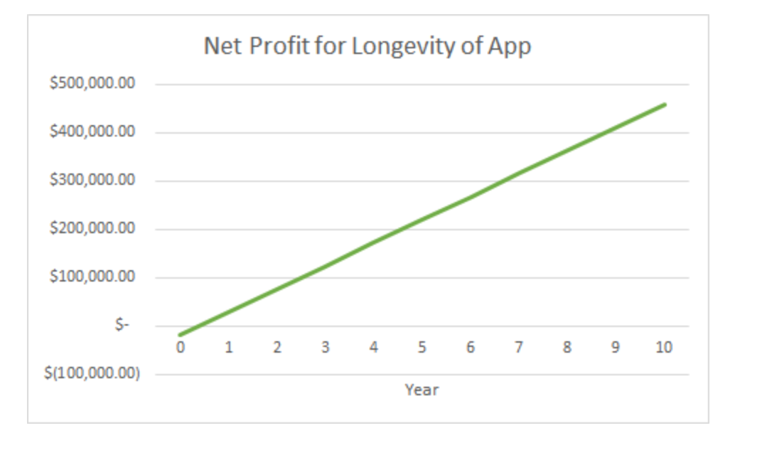

Slide 19
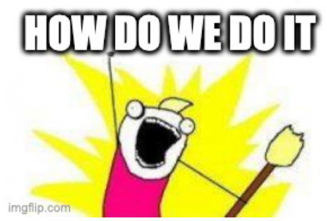

Slide 20
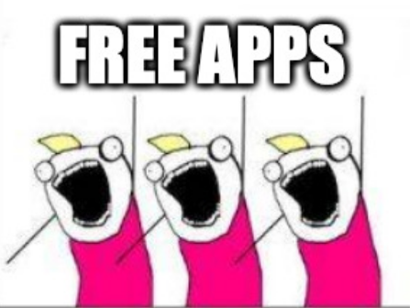

Slide 21
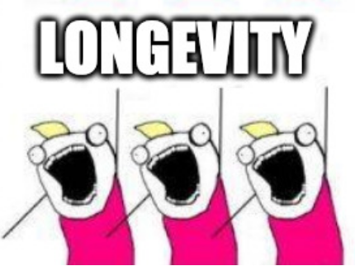

Slide 22
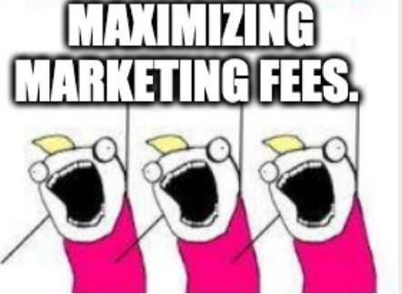

Slide 23
All Of The Apps We Picked:
Are FREE
Have a 4.5 Star Rating and Above
Are on both platforms

Slide 24
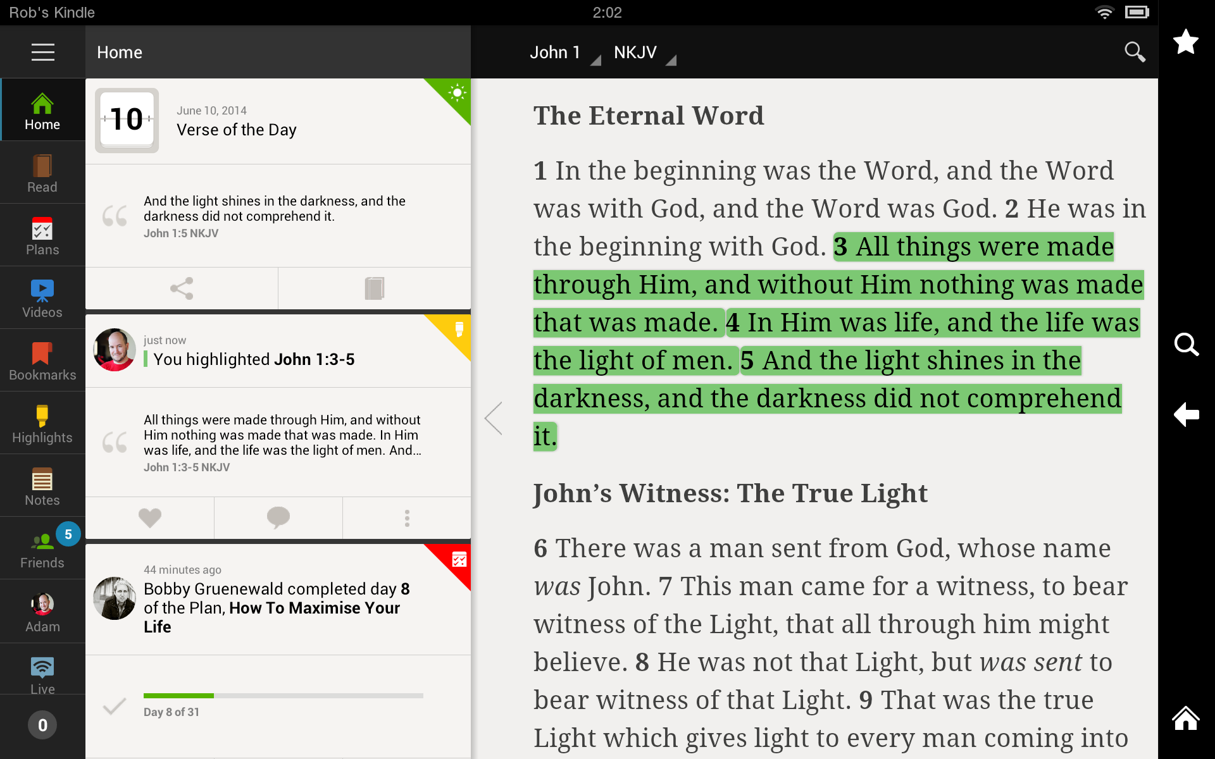
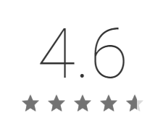
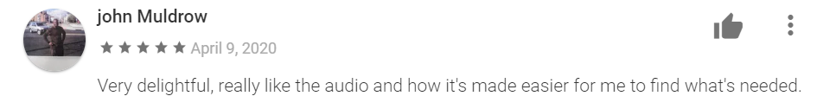
THE BIBLE

Slide 25
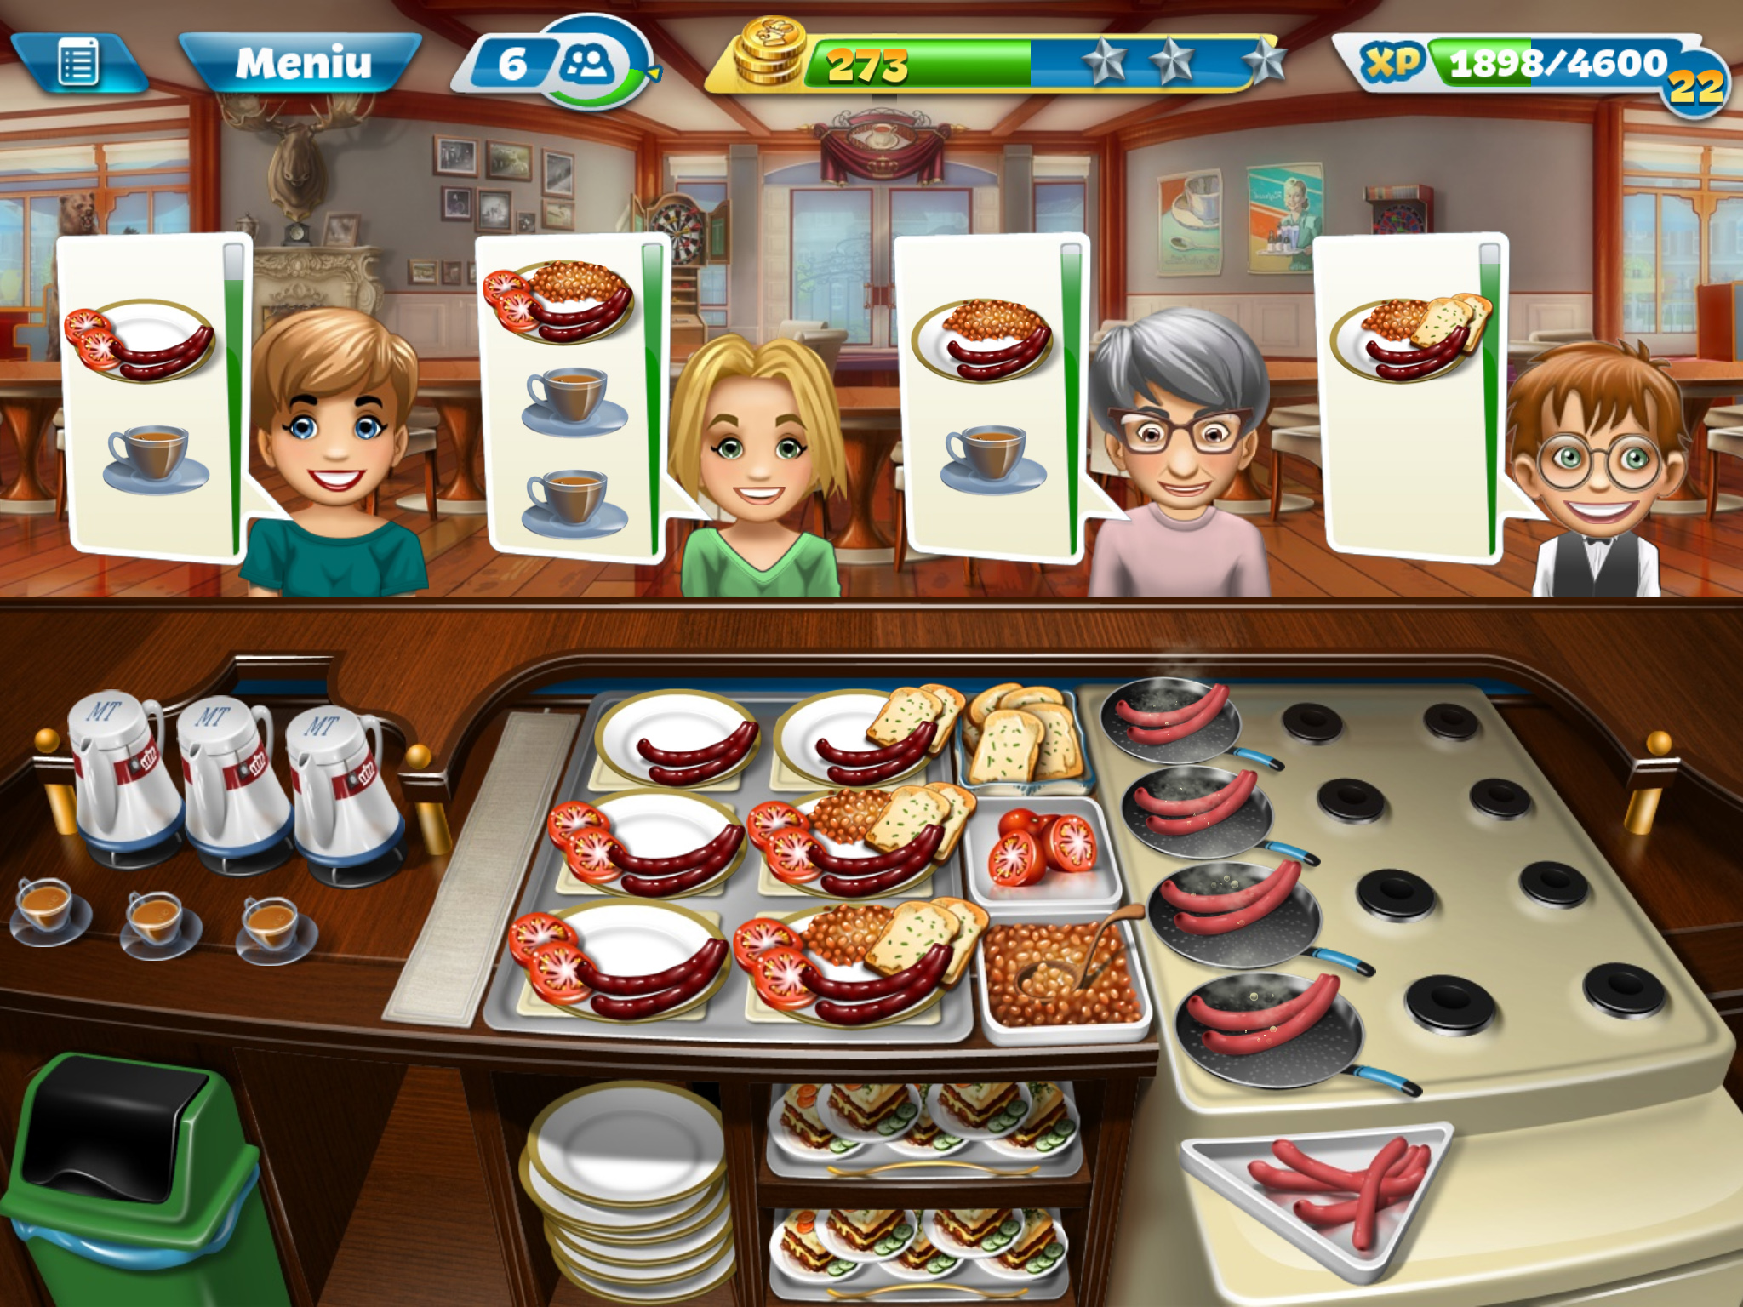
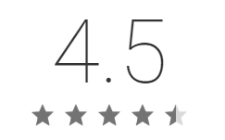
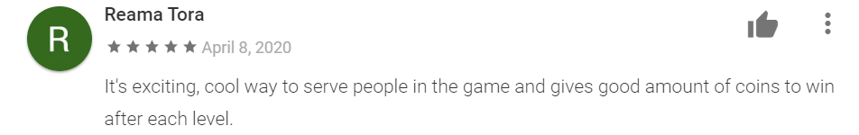
COOKING FEVER

Slide 26
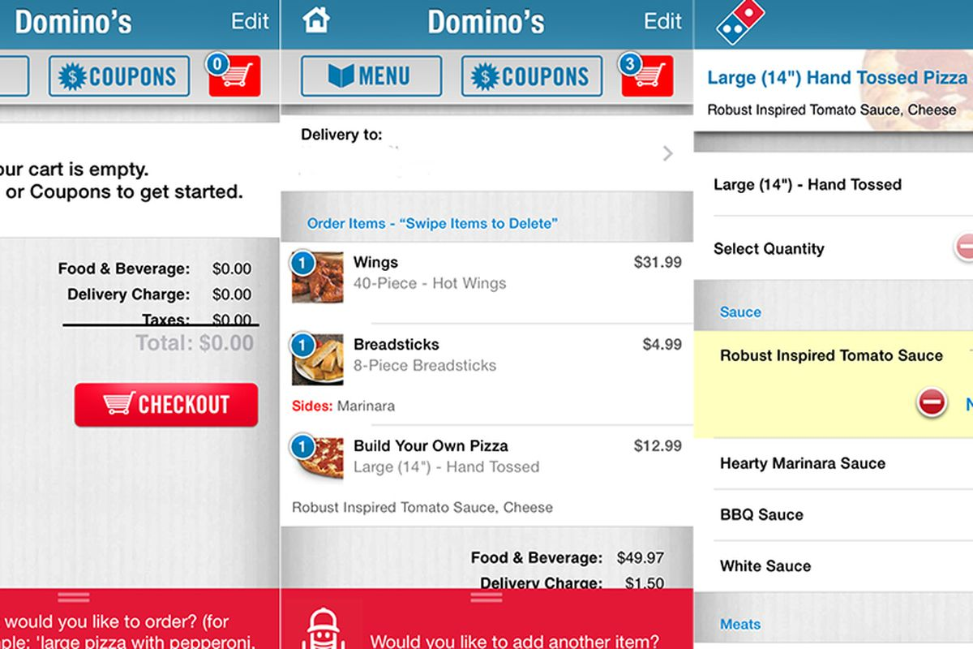
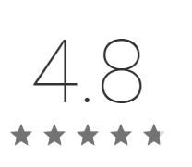
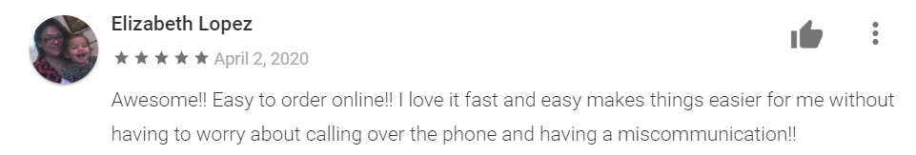
DOMINOS PIZZA

Slide 27
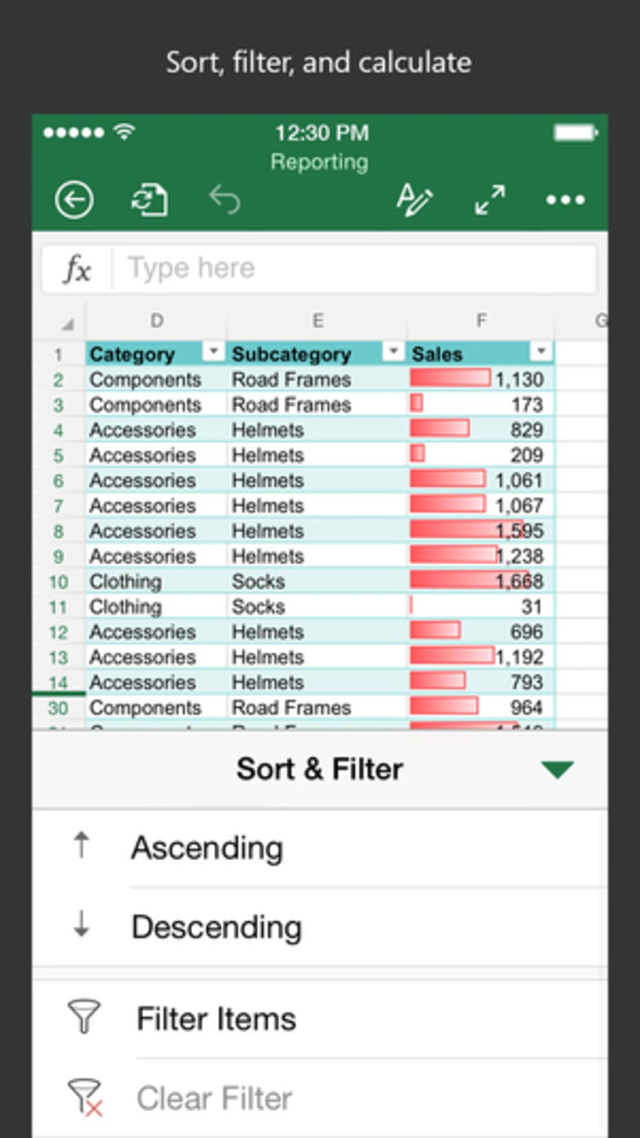
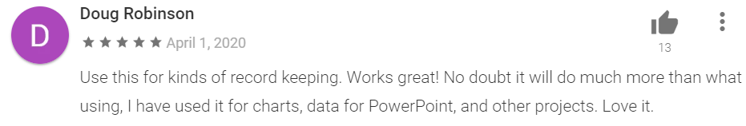
MICROSOFT EXCEL

Slide 28
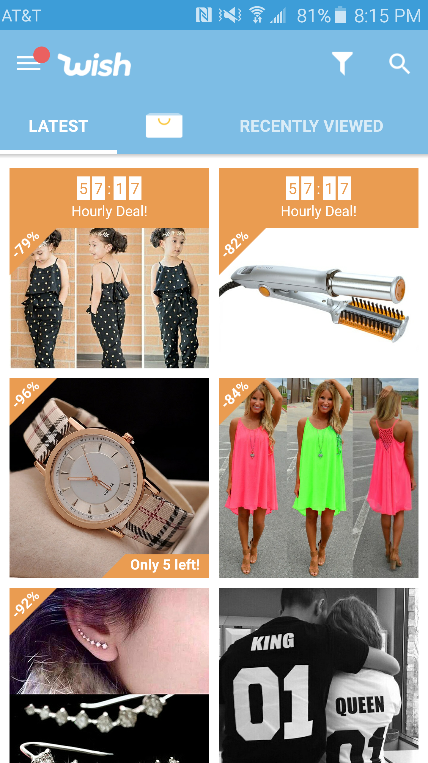
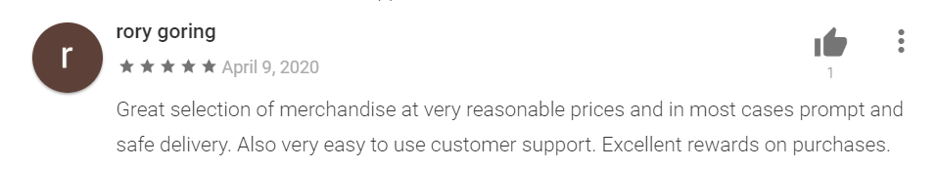
WISH

Slide 29
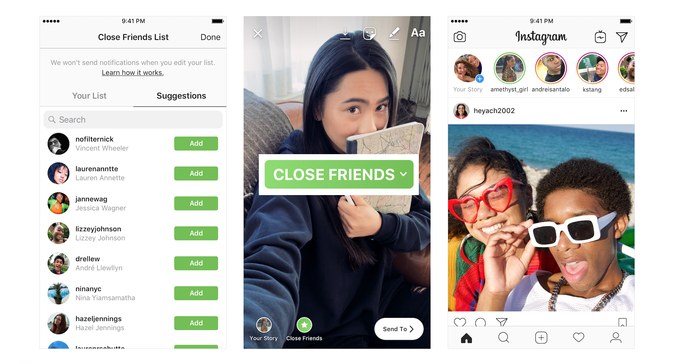
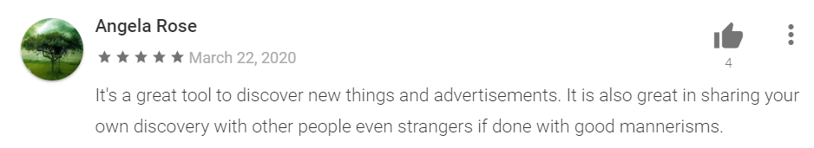
INSTAGRAM

Slide 30
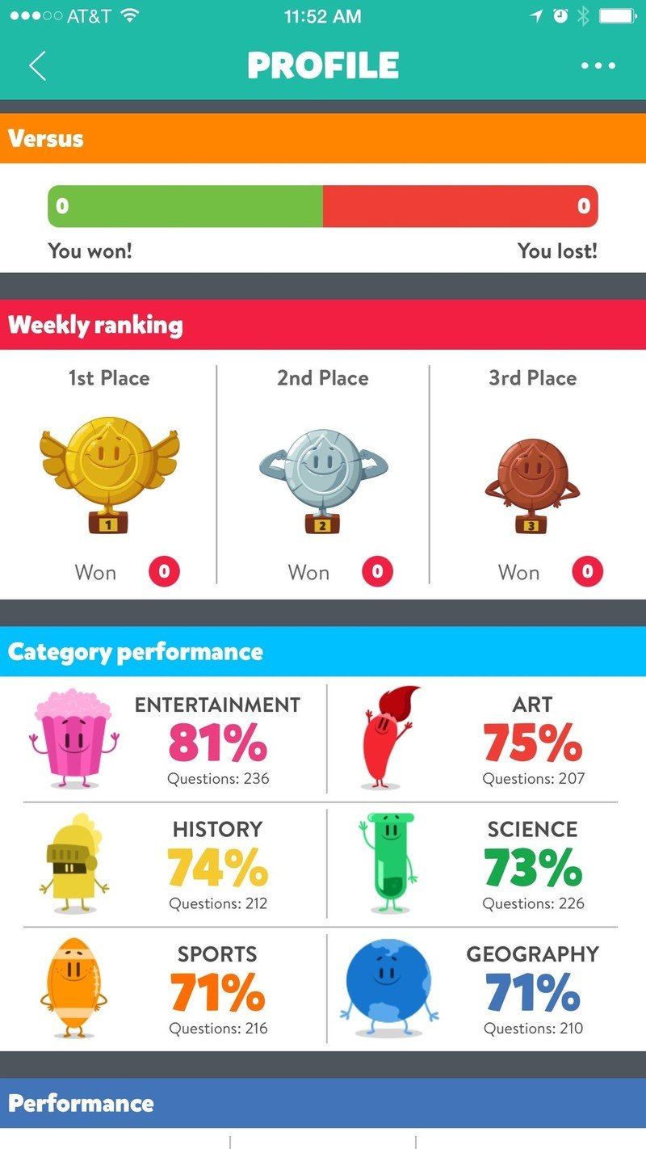
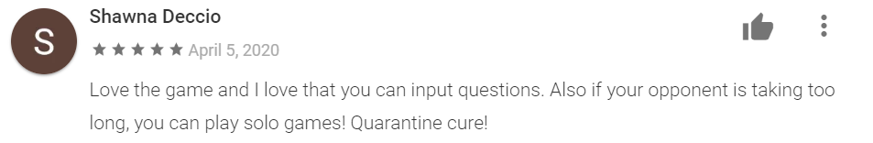
Trivia Crack

Slide 31

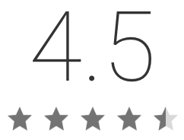
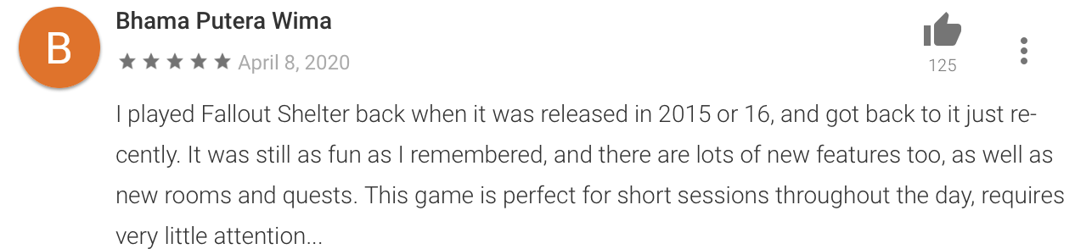
Fallout Shelter

Slide 32
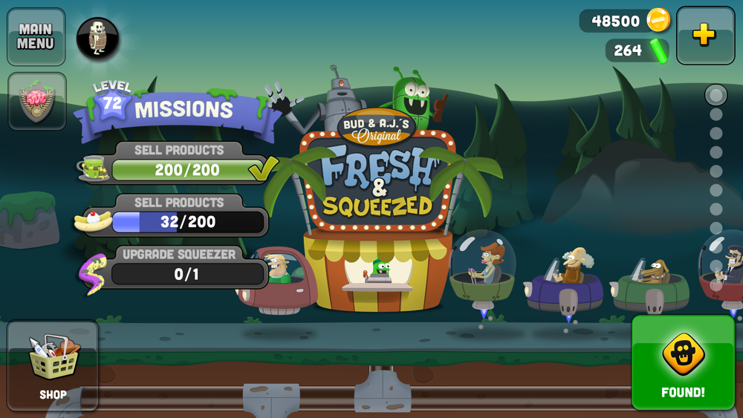
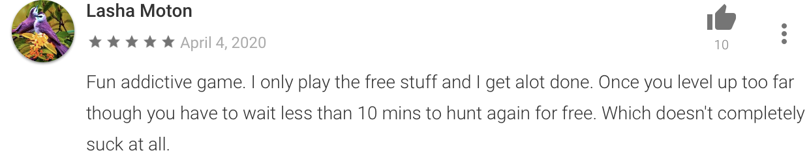
Zombie Catchers

Slide 33
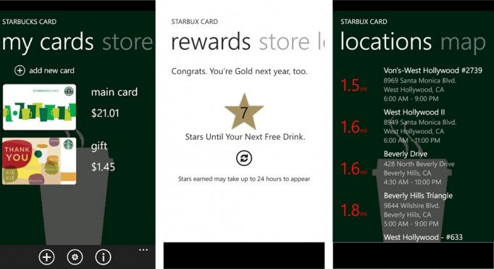
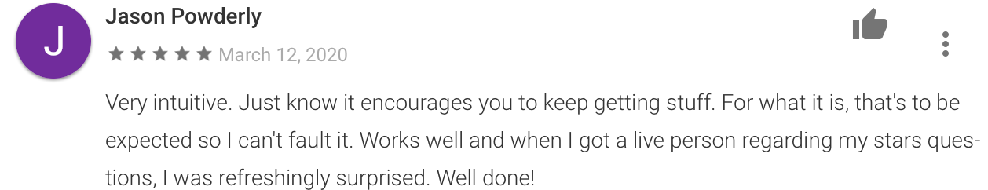
Starbucks
Always keep caffeinated.

Slide 34
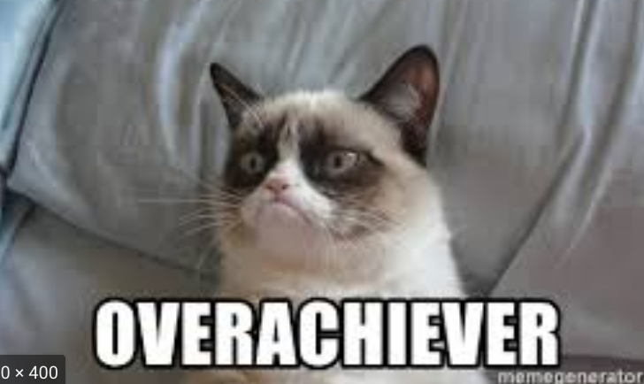

Slide 35
Top 3 Genres with Highest Ratings
1 Food & Drink
2 Finance
3 Shopping

Slide 36
Food & Drink Top Apps
Door dash

Slide 37
Finance
Chase Mobile USAA AMEX

Slide 38
Shopping
ASOS, Fuel Rewards Program

